Slide 15
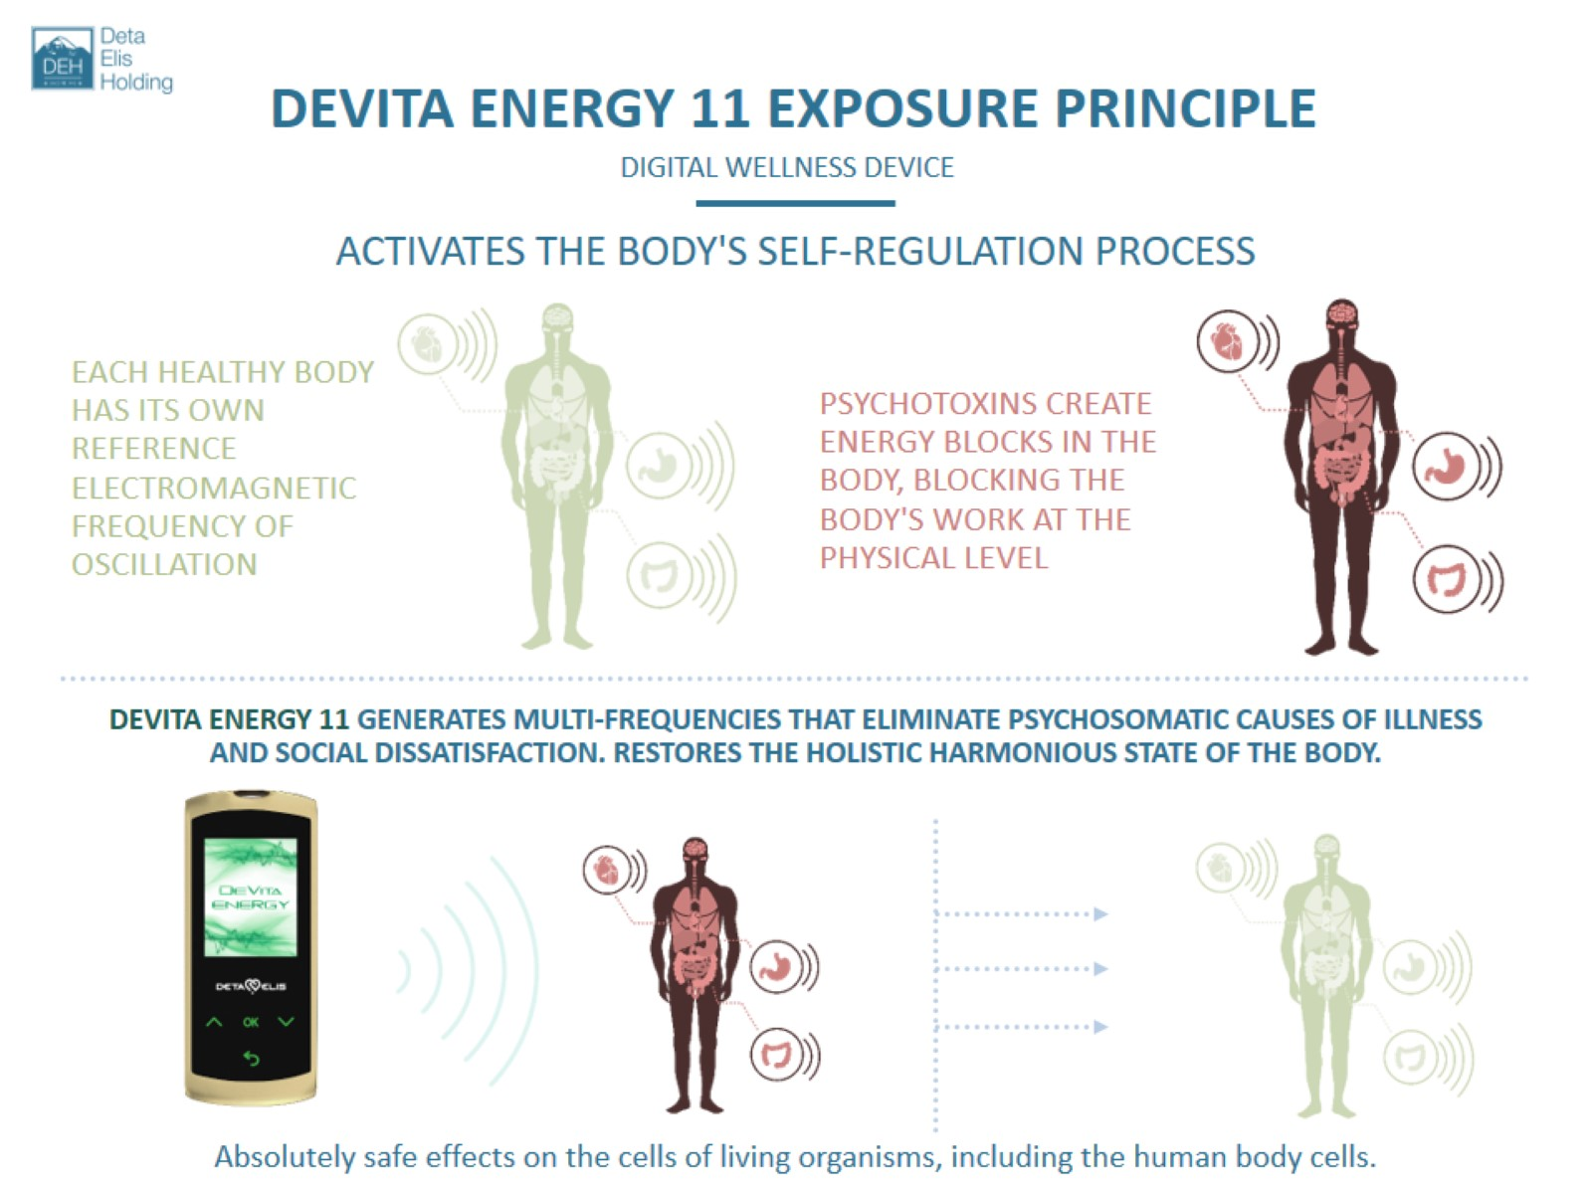

Slide 17
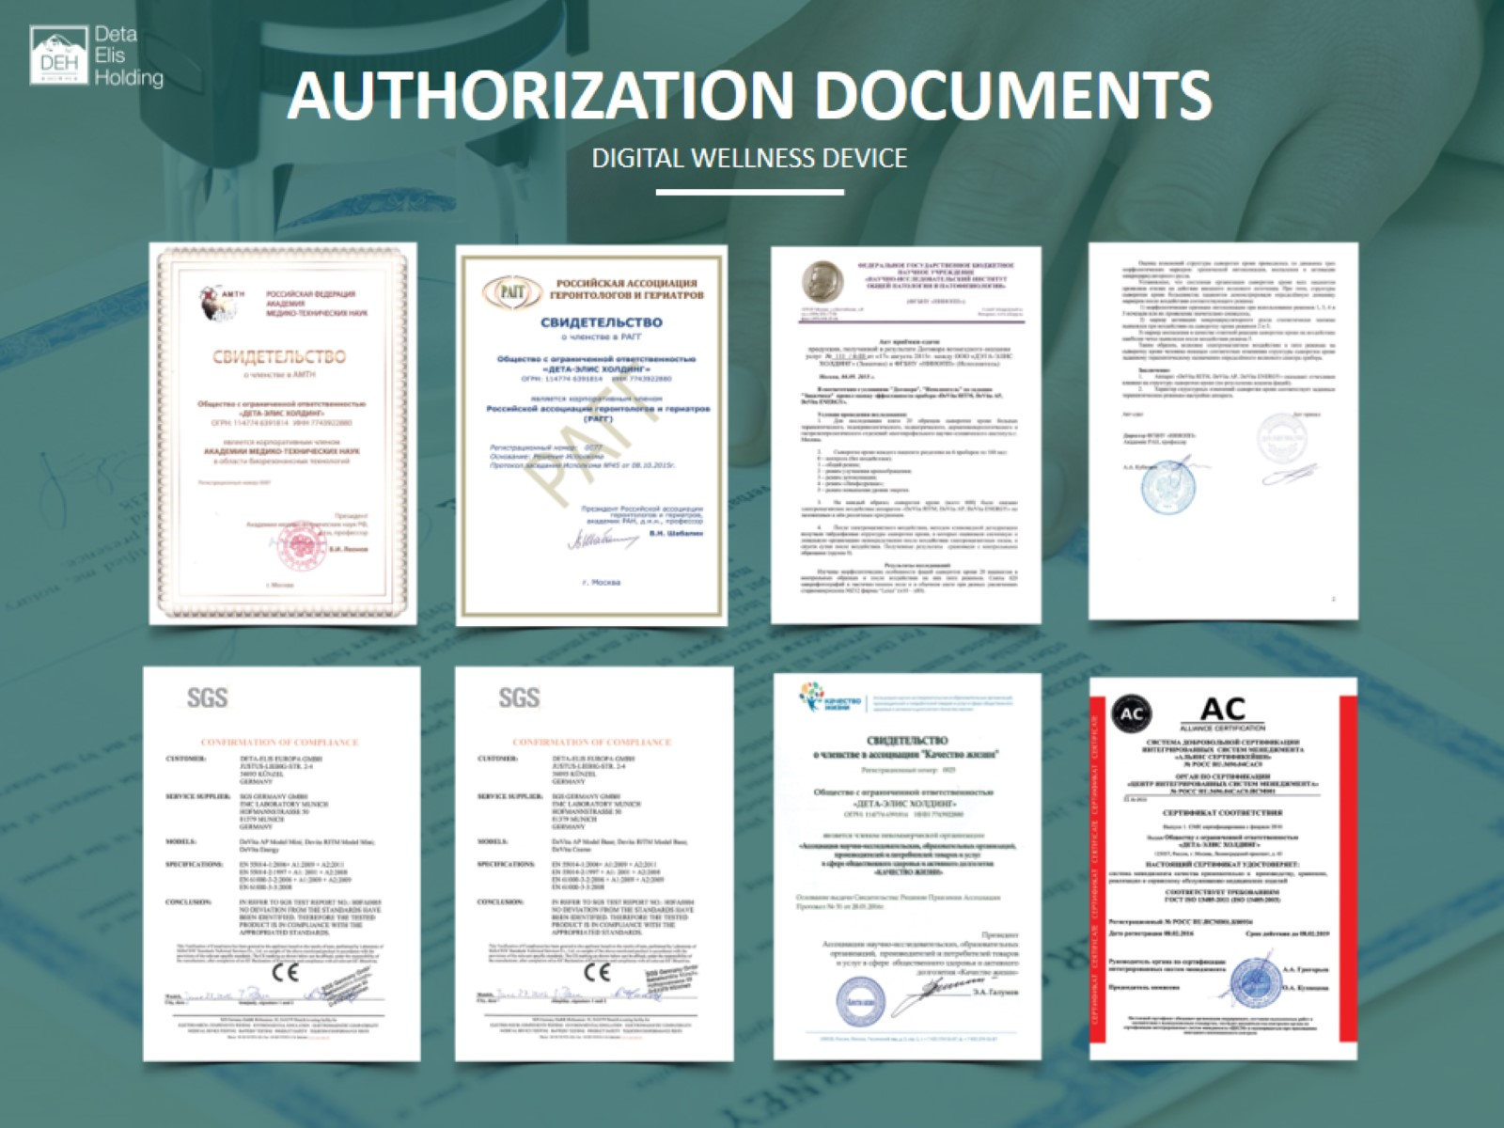
AUTHORIZATION DOCUMENTS

